Slide 1



The 18th International Conference on Power Electronics and Motion Control
Comparison of Inverter Topologies Suited for Integrated Modular Motor Drive Applications
Hakan SARAÇ
hakan.sarac@metu.edu.tr
Department of Electrical and Electronics Engineering
Middle East Technical University

Slide 2

Outline
Introduction
Integrated Modular Motor Drive (IMMD) Technology
Inverter Evaluation & Results
Conclusions
References

Slide 3
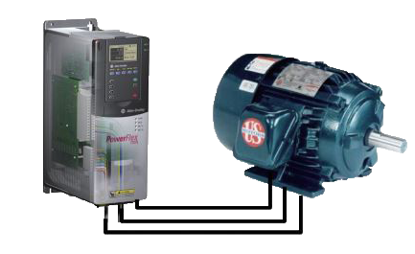
Introduction
Long cable effect
Low power density

Slide 4
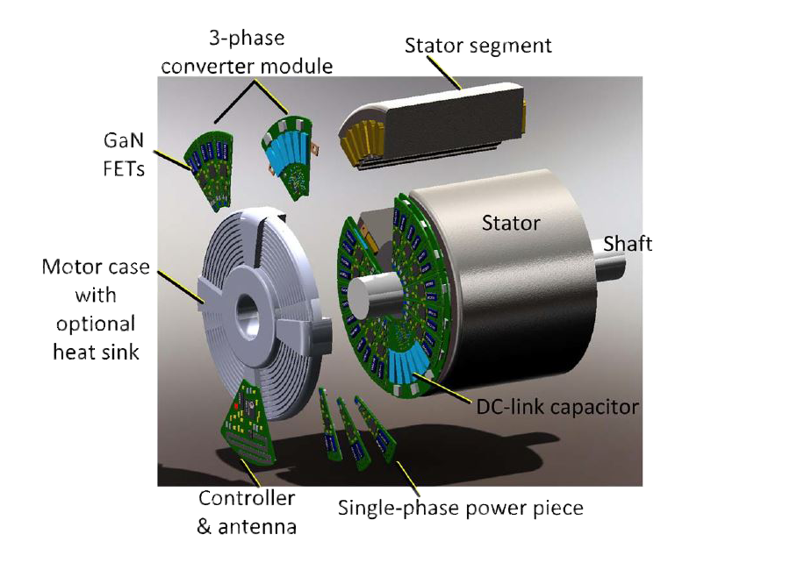
IMMD Technology
Reduced overall size
Modular structure
Fault tolerance capability

Slide 5
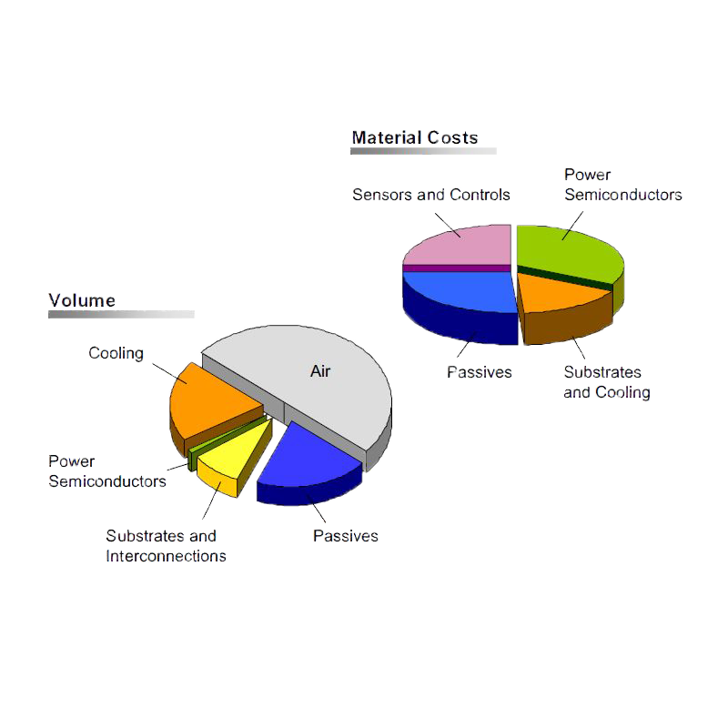
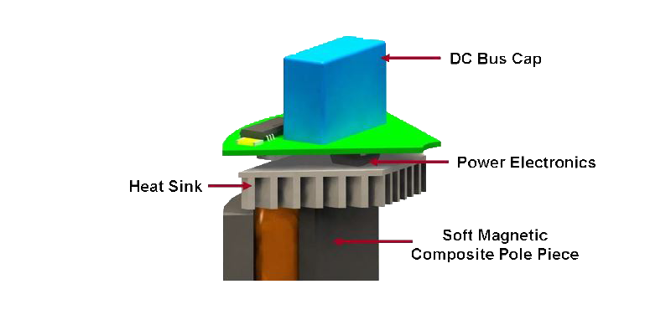
IMMD Technology
Drive challenges in IMMD
Mechanical vibration
Compact drive circuit
Cooling
Notes:
How to achieve compact drive and cooling?

Slide 6
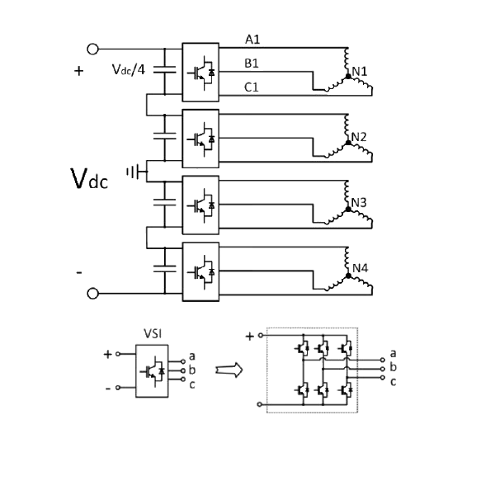
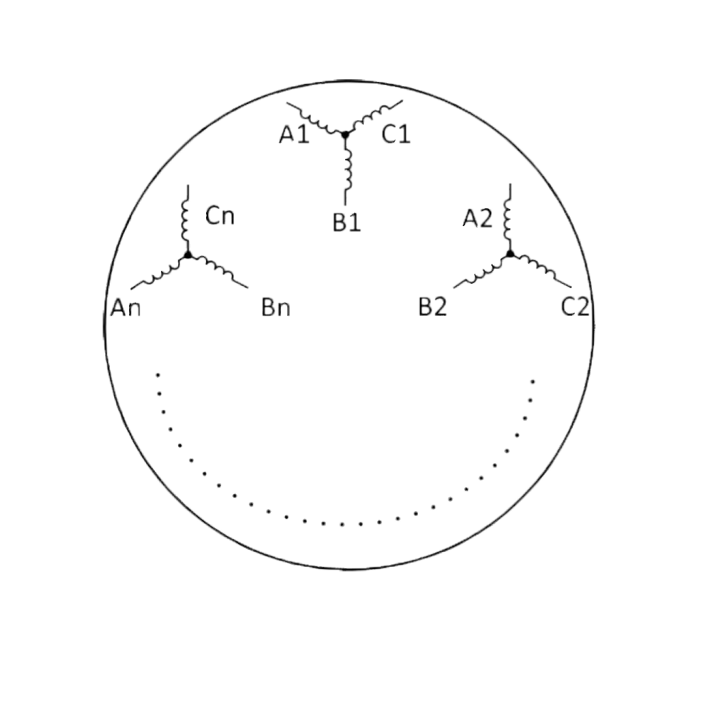
IMMD Technology
Advantages that IMMD provides
Separately excited coil groups
Interleaving can be utilized
Various configrations can be applied (series, parallel)

Slide 7
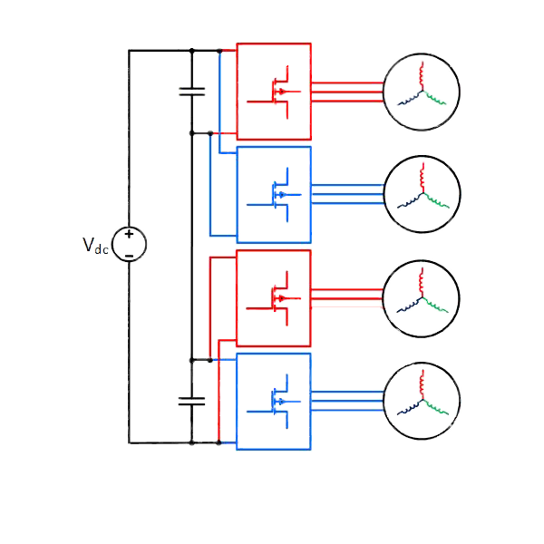
Inverter Evaluation & Results
Evaluated Circuits
2 level VSI, IGBT, 1 module
2 level 2 series VSI, GaN, 2 modules
2 level 2 series 2 parallel VSI, GaN, 4 modules
3 level VSI, GaN, 1 module
3 level 2 parallel VSI, GaN, 2 modules
Notes:
8kW

Slide 8
Inverter Evaluation & Results
Motivations for series&parallel connections
Voltage ratings of GaNs
Interleaving
Better thermal performance
Fault tolerance
Lower switching losses, will be remarked

Slide 9
Inverter Evaluation & Results
Results
8kW
0.9 power factor
0.9 modulation index

Slide 10
Inverter Evaluation & Results
Results
Loss components of the drive
Efficiency vs. switching frequency
Efficiency vs. output power

Slide 11
Inverter Evaluation & Results
Results
10kHz
50kHz
50kHz
50kHz
50kHz

Slide 12
Inverter Evaluation & Results
Results

Slide 13
References
[1] J. Wang, Y. Li and Y. Han, "Integrated Modular Motor Drive Design WithGaNPowerFETs," in IEEE Transactions on Industry Applications, vol. 51, no. 4, pp. 3198-3207, July-Aug. 2015.
doi: 10.1109/TIA.2015.2413380
[2] J. Wang and Y. Han, "A new concept of multilevel converter motor drive with modular design and split winding machine," 2014 Power and Energy Conference at Illinois (PECI), Champaign, IL, 2014, pp. 1-6.
doi: 10.1109/PECI.2014.6804550
[3] M. März, A. Schletz, B. Eckardt, S. Egelkraut and H. Rauh, "Power electronics system integration for electric and hybrid vehicles," 2010 6th International Conference on Integrated Power Electronics Systems, Nuremberg, 2010, pp. 1-10.
[4] N. R. Brown, T. M. Jahns and R. D. Lorenz, "Power Converter Design for an Integrated Modular Motor Drive," 2007 IEEE Industry Applications Annual Meeting, New Orleans, LA, 2007, pp. 1322-1328.
doi: 10.1109/07IAS.2007.205
[5] T. M. Jahns and H. Dai, "The past, present, and future of power electronics integration technology in motor drives," in CPSS Transactions on Power Electronics and Applications, vol. 2, no. 3, pp. 197-216, Sept. 2017.
doi: 10.24295/CPSSTPEA.2017.00019
[6] GaN Systems, “GaN Systems.” [Online]. Available: http://www.gansystems.com/. [Accessed: 15-Jan-2018].
[7] Infineon, “Infineon IGBTs.” [Online]. Available: https://www.infineon.com. [Accessed: 07-Mar-2018].

